Slide 1
Aakash Goel https://www.linkedin.com/in/goelaakash123/
Session 2:
Digital Image Fundamentals
Acknowledgement: Slide Materials adopted from - Intro to Computer Vision (Cornell Tech); Noah Snavely, prepared by the lead instructor Prof S P Vimal , modified (added some content) by Aakash Goel

Slide 2
Topics
CV 1: Digital Image Fundamentals
Image Representation
Image Digitization ( Sampling & Quantization)
Digital Image Properties

Slide 3
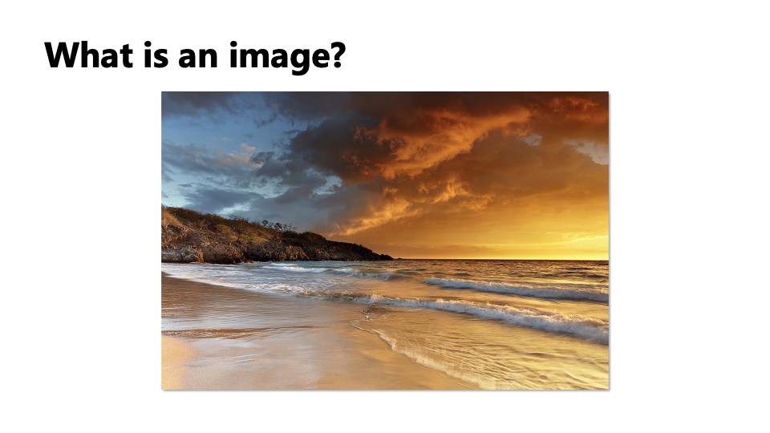
CV 2: Digital Image Fundamentals
For humans, it’s a scene or a photograph. But for a computer, it’s a grid of numbers!

Slide 4
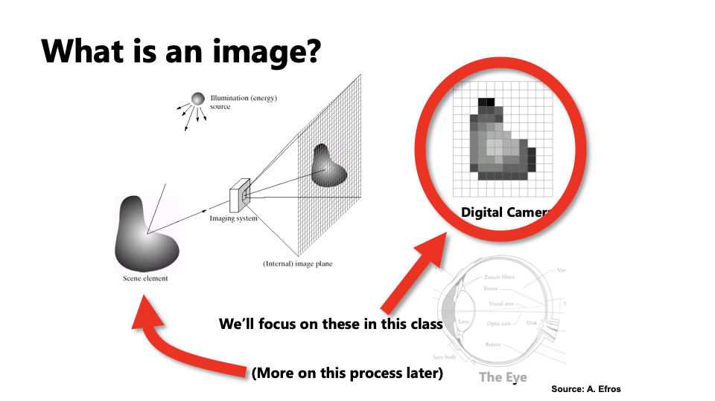
CV 2: Digital Image Fundamentals
Notes:
One way to think of an image is as a record of a set of light rays that bounce through space and hit a piece of light-sensitive film or a digital sensor.
Another way is to think of an image as just a grid of pixel values.
Another way is to think of an image as a response of our retinas to a light stimulus. In this class, we’ll focus on digital images. Later, we’ll come back to talk about how images are formed via the transmission of light through a scene.

Slide 5
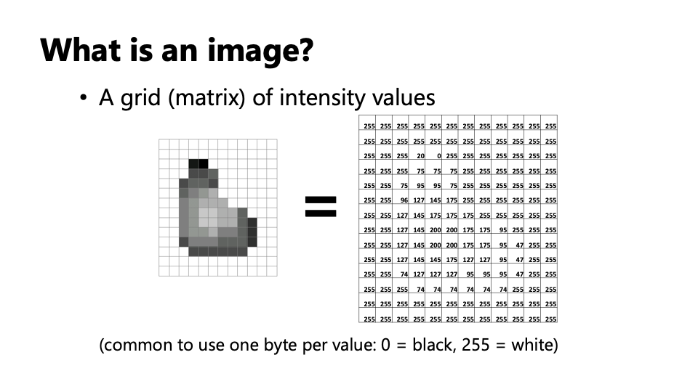
CV 2: Digital Image Fundamentals

Slide 6
✅ Key Points to Cover:
What is an Image?
A 2D grid (matrix) of pixel values
Each pixel = one point of color/light
Image is represented as:
Grayscale: 2D matrix (values 0–255)
Color (RGB): 3D matrix (height × width × 3)
Color Channels (RGB)
R, G, B each is a separate matrix
Together they form the full color image
Analogy:
“Imagine Lego blocks. Each block is a pixel, and the color on it comes from combining red, green, and blue lights.”
SHOW CODE

Slide 7
Image Digitization – Sampling & Quantization
By the end of this topic, students should be able to:
Understand what it means to convert a real-world image into digital form.
Know the concepts of sampling (spatial resolution) and quantization (color/brightness resolution).
Visualize how these affect image quality.
Experiment with Python code to simulate the concepts.

Slide 8
Real-world motivation
Let’s start with a basic question — when we take a photo with a camera, how does that real-world scene become a file on your phone?
That process is called Image Digitization — converting a continuous image into numbers that a computer can store.
But how do we convert a beautiful, infinite-color scene into a bunch of numbers? We need to answer two questions:
Where to measure the image? → Sampling
What value to store at each point? → Quantization
Think of it like drawing a painting using Lego bricks. How many bricks you use (sampling) and how many colors are available (quantization) define how close the result looks to the real image."

Slide 9
Sampling
Sampling decides how many pixels we use to represent the image.
More pixels → more detail.
Fewer pixels → blocky, less clear image.
🎨 Analogy:
"Imagine a huge poster of Mona Lisa. If I ask you to recreate it using only 10×10 squares (like tiles), you lose a lot of detail. But if I let you use 1000×1000 squares, the image is almost lifelike.“
SHOW CODE

Slide 10
Code Explanation
🔸 Line 1: img_small = cv2.resize(img, (32, 32), interpolation=cv2.INTER_NEAREST)
We are downsampling the image to just 32x32 pixels — extremely low spatial resolution.
cv2.resize() is a function that resizes an image to the specified size.
interpolation=cv2.INTER_NEAREST tells OpenCV how to fill in pixel values during resizing.
🔸 Line 2: img_large = cv2.resize(img_small, img.shape[1::-1], interpolation=cv2.INTER_NEAREST)
Here, we resize the small image back to its original dimensions so we can visually compare it with the original.
img.shape[1::-1] gives us the original image's width and height in the correct format (OpenCV needs width × height).
Again, we use INTER_NEAREST to retain the blocky nature and not blend pixels during upsampling.

Slide 11
Interpolation method
When resizing an image, especially during enlargement or reduction, OpenCV needs to estimate the new pixel values. Interpolation methods determine how these estimates are made.
Interpolation Method | Description
cv2.INTER_NEAREST | Picks the nearest pixel value. Fastest, but can look blocky. Great for preserving sharp edges or simulating digital pixelation.
cv2.INTER_LINEAR (default) | Bilinear interpolation (weighted average of 4 neighbors). Smoother than nearest.
cv2.INTER_AREA | Preferred for shrinking images. Computes the pixel area relation. Preserves details better.
cv2.INTER_CUBIC | Bicubic interpolation over 4×4 pixel area. Smoother but slower.
cv2.INTER_LANCZOS4 | Very high-quality interpolation over 8×8 pixel neighborhood.

Slide 12
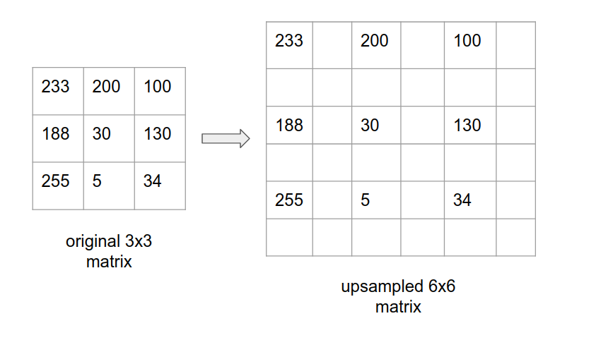

Slide 13
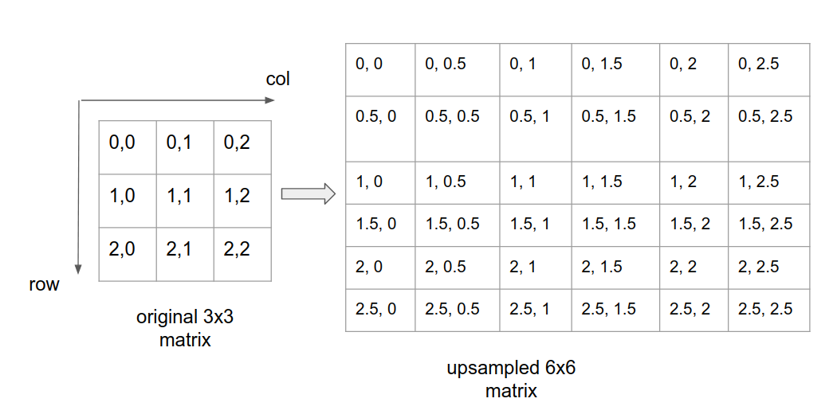
Consider an input matrix of size 3x3 with each cell containing some pixel values in the range 0–255. row, col indices starts from 0 to n-1 where n is the row/col length.
Now let’s create a new 6x6 output(upscaled) empty matrix.
Inorder to start filling the pixel values for the new matrix, we first have to represent the output coordinate space interms of the input coordinate space i.e. for every (row, col) in the output matrix, what is the corresponding (row, col) in the input matrix? This is just the scaling factor which is 1/2 in our case.
To make it more clearer, the row scaling factor is 1/2 and column scaling factor is 1/2(row and col will have separate scaling factors but since our eg considers a square matrix, both are same here).
row 0, col 0 in output is mapped to row 0, col 0 in input, whereas row 1, col 1 in output is mapped to row 0.5, col 0.5 in input and so on.

Slide 14
One can see that there are known cells such as 0, 0 or 2, 2(in integers) and there are also unknown cells such as 1.5, 2 or 0, 2.5(in floating point).

Slide 15
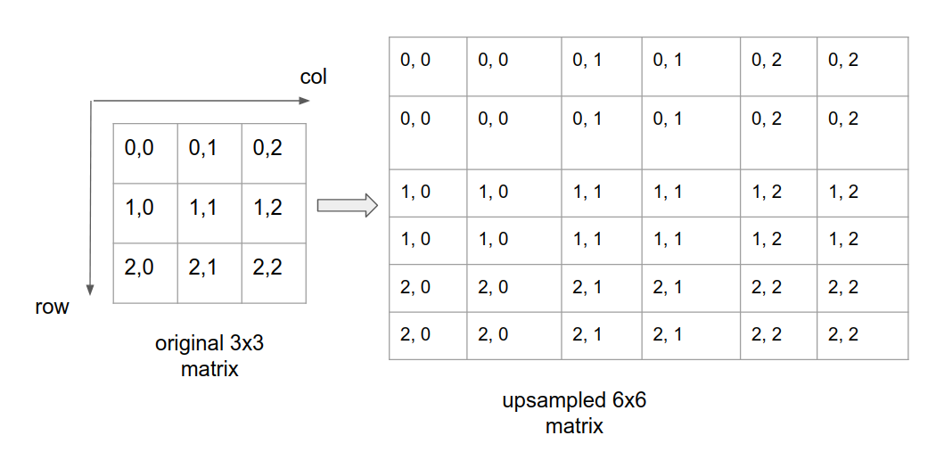
Nearest Neighbour Interpolation:
Here in the above image, a simple way to find the values for unknown cells such as (0.5, 0.5) or (2, 2.5) is to simply round them off to nearest integer. for eg: (2, 2.5) to (2, 2) or (1.5, 2.5) to (1, 2). This is called nearest neighbour interpolation.

Slide 16
Bilinear Interpolation – Teaching Method 1
Bilinear interpolation makes use of linear interpolation method to compute the pixel values for a new image.
The method works as follows:
For any unknown (row, col) cell in the upsampled matrix, pick the 4 nearest pixels. These nearest pixels can be obtained by doing int(row), int(col), int(row) + 1 and int(col) + 1. Let’s call it row1, col1, row2 and col2
Perform linear interpolation at (row1, col) using (row1, col1) and (row1, col2) and similarly linear interpolation at (row2, col) using (row2, col1) and (row2, col2). Both are along x-directions.
Do one final linear interpolation at (row, col) using (row1, col) and (row2, col).
The above steps are repeated for every unknown (row, col) cell in the new matrix.
Note that the same pixel value can be obtained by doing two linear interpolation along y-directions first and then along x-direction.

Slide 17
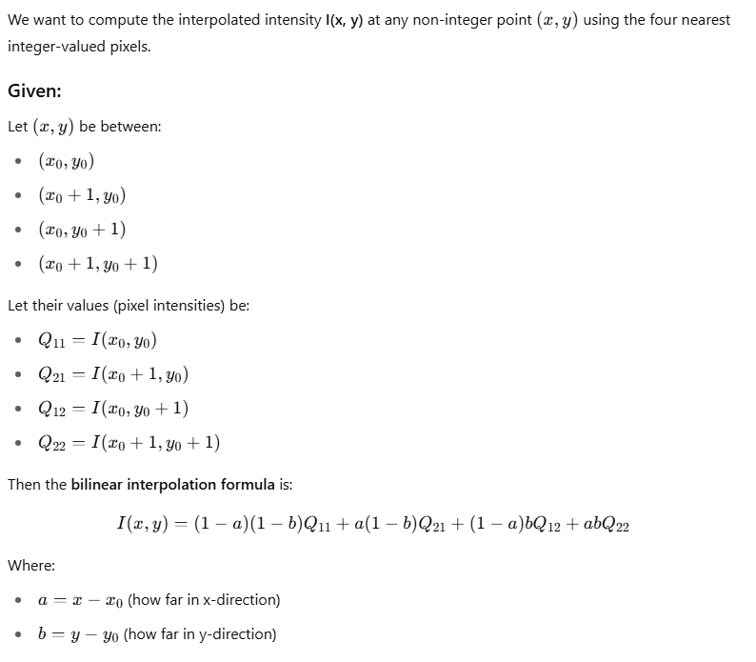
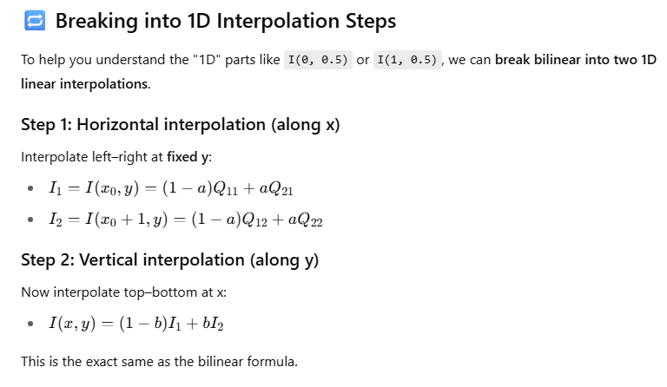
Bilinear Interpolation – Teaching Method 2

Slide 18
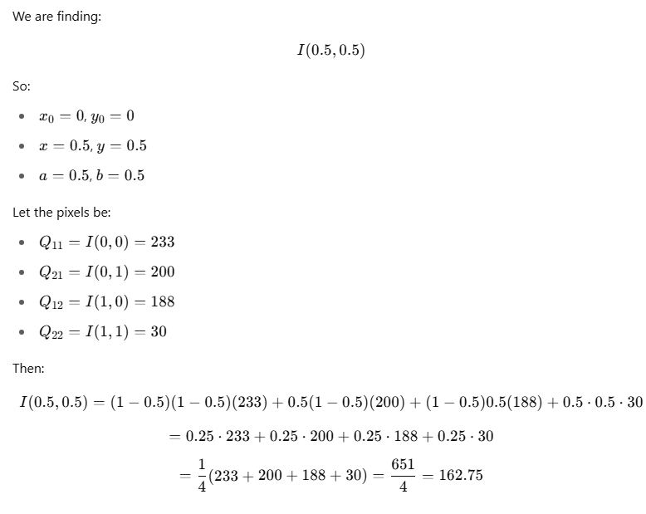
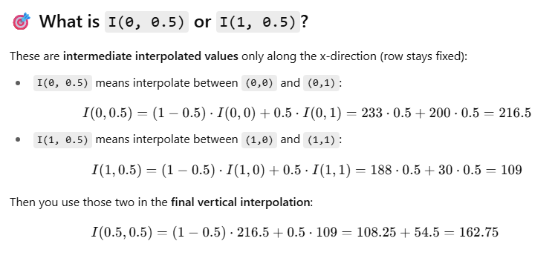
Applying it to example
Notes:
https://raghul-719.medium.com/basics-of-computer-vision-1-image-resizing-97fca504cd63

Slide 19
Quantization (Color Resolution)
Quantization decides how many shades or levels of brightness/colors we store for each pixel.
8-bit grayscale → 256 levels (0 to 255)
If we reduce it to 2 or 4 levels, we get poor image quality.
🎨 Analogy:
"Think of drawing with crayons. If I give you 256 crayons, you can match any shade. But if I give you only 2 — say black and white — the result looks like an old cartoon.“
SHOW CODE

Slide 20
What is Quantization in Image Processing?
Quantization is the process of reducing the number of possible pixel values. In an 8-bit grayscale image, pixel values range from 0 to 255 (256 levels). Quantization means we compress this range to fewer levels, e.g., just 4 or 8 or 16 gray levels.
🔍 Why do we do this?
For compression (reduce storage).
For simplifying data.
For simulating how early devices or sensors worked.
Imagine painting with only 4 colors instead of 256. Some subtle shades will disappear — nearby shades are rounded off to the closest available one.
How many tones or shades each pixel can represent.

Slide 21
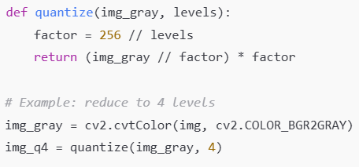
Quantization Code - Math
Let’s say levels = 4:
factor = 256 // 4 = 64
img_gray // 64: Divides every pixel by 64 and removes the remainder, giving values: 0, 1, 2, or 3.
Multiply back: 0×64=0, 1×64=64, 2×64=128, 3×64=192
So now, all pixel values are rounded to one of 4 values only:
[0, 64, 128, 192] — this is quantized image with 4 gray levels.

Slide 22
Combine Sampling & Quantization
Let’s now combine both effects. If we reduce both the number of pixels and the number of brightness levels, the image can become very abstract or symbolic. That’s why high-quality cameras invest in both high resolution and color depth.

Slide 23
Digital Image Properties
🎯 Learning Objectives
By the end of this section, students should understand:
What makes up a digital image.
How resolution (spatial and intensity) affects image quality.
The role of bit depth, dynamic range, and file formats.

Slide 24
Introduction to Digital Image Properties
Have you ever zoomed into a photo and noticed it becoming blurry or pixelated? That’s because digital images have properties and limits — today, we’ll understand them.
Digital Image = Matrix of Numbers
Each pixel has:
A location (x, y)
A value (intensity or color)
Properties define how detailed and rich this image can be.

Slide 25
Bit Depth
A digital image is just a grid of tiny squares — we call them pixels. Each pixel holds a value that tells how bright it is (in grayscale), or what color it is (in color images).
Each pixel in a grayscale image is stored as a number. That number represents how bright or dark the pixel is.
Computers store everything in 1s and 0s — binary. So how do we store a number like 0–255 using binary digits (bits)? 👉 That’s where bit depth comes in.
Bit Depth tells us how many bits (binary digits) are used to store each pixel value.

Slide 26
Bit Depth | Bits Used | Binary Range | Intensity Levels | Shades / Examples | Analogy
1-bit | 1 | 0 or 1 | 2 | Black, White | Like a light switch — ON or OFF
2-bit | 2 | 00 to 11 (0–3) | 4 | Black, dark gray, light gray, white | A poster with 4 paint shades
4-bit | 4 | 0000 to 1111 (0–15) | 16 | More detailed grayscale | A basic sketch using a pencil with 16 pressure levels
8-bit | 8 | 00000000 to 11111111 (0–255) | 256 | Smooth grayscale (used in most images) | A dimmer switch with fine control
16-bit | 16 | 0 to 65535 | 65,536 | Very fine intensity gradations (scientific, medical) | Professional camera with ultra-precise exposure
Use Case | Bit Depth | Why
Medical Imaging (CT/MRI) | 12-16 bit | To capture subtle tissue differences
Professional Photography | 12-14 bit RAW | Better color grading and shadow detail
Web Images | 8-bit | Balance between size and quality
HDR Video | 10-bit+ | To display more detail in high contrast scenes

Slide 27
🖼️ Bit Depth in Color Images
In color (RGB) images:
Each channel (Red, Green, Blue) has its own bit depth.
8-bit per channel is standard → total = 24 bits per pixel (8×3).
Total colors possible = 2^8 × 2^8 × 2^8 = 16.7 million colors.
For HDR imaging, we might use 10-bit or 16-bit per channel, resulting in billions of color shades.

Slide 28
Dynamic Range
Dynamic Range is the ratio between the brightest and darkest details a camera or display can capture or show.
It’s how well an image can represent both very dark and very bright areas at the same time.
🌗 Analogy:
Imagine your eyes walking from a dark room into bright sunlight. A camera with limited dynamic range either:
Overexposes bright areas (burned out), or
Underexposes shadows (all black).
Higher dynamic range = more detail preserved in both bright and dark regions.
Higher bit depth gives us:
More intensity levels
So, more steps between black and white
Thus, better dynamic range
SHOW CODE

Slide 29
Color Image
A color image is composed of multiple channels — typically Red, Green, Blue (RGB).
Each pixel has three intensity values: one for each channel.
Together, they define the color at that pixel.
📌 Example:
A pixel in grayscale might be 128
A pixel in color might be (123, 85, 200) — Red=123, Green=85, Blue=200
Think of RGB like mixing paints:
Red + Green = Yellow
Red + Blue = Magenta
All = White
None = Black

Slide 30
HSV : Hue-Saturation-Value
Hue = actual color (0–360 degrees)
Saturation = how pure the color is
Value = brightness
🧠 Analogy:
HSV is like picking color in a paint app:
Hue is the color wheel
Saturation is the slider for gray-to-pure
Value is how bright or dark the color is
HSV's real benefit is not in display but in color filtering, thresholding, and segmentation, especially for things like detecting a specific color.
HSV separates the concept of color (Hue), vibrancy (Saturation), and brightness (Value).
HSV is more aligned to how humans perceive colors, which is helpful for tasks like:
Detecting a red ball (by filtering hue)
Enhancing low-light images (by modifying value)

Slide 31
Hue in HSV directly represents color — and red is at the ends of the Hue scale (around 0° and 180°).
HSV Range: [H, S, V]
Hue: 0–179 in OpenCV (not 0–360!)
Saturation: 0–255 (how vibrant)
Value: 0–255 (brightness)
Red wraps around the HSV hue wheel. So in OpenCV:
Some red tones are near 0–10
Others are near 160–180
Real Hue (Degrees) | OpenCV Hue Value
0° (Red) | 0
360° (Red again) | 179
[0, 100, 100] = Red hue, medium saturation, medium brightness [10, 255, 255] = Red-orange hue, very vibrant and very bright
✅ Lower Bound: [0, 100, 100]
Minimum Hue: 0 → red starts here
Minimum Saturation: 100 → filters out dull, grayish tones
Minimum Value: 100 → filters out very dark pixels
✅ Upper Bound: [10, 255, 255]
Maximum Hue: 10 → includes red to reddish-orange
Max Saturation & Brightness: 255 → allow all vivid/bright pixels

Slide 32
Readings:
Digital Image Processing, Rafael C. Gonzalez & Richard E woods, Third Ed, Chapter 2
References for hands-on work:
https://www.kaggle.com/code/gauravduttakiit/image-processing-notebook

Slide 33
Thank you

